Slide 1







ASSESSMENT 1
skills portfolio
Aleina Janin Diolola Ricamara

Slide 2



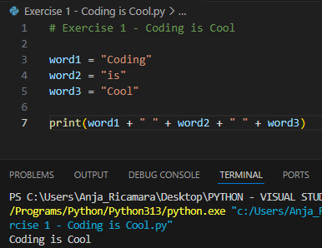

EXERCISE 1: CODING IS COOL
Output!!! ->

Slide 3
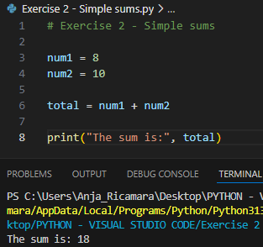



EXERCISE 2 - SIMPLE SUMS
OUTPUT ->

Slide 4


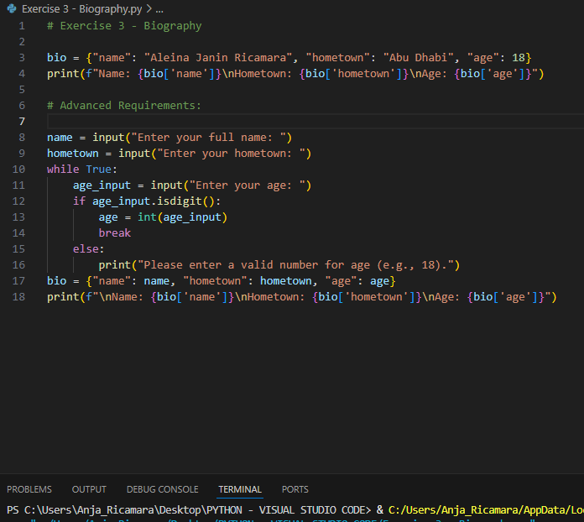

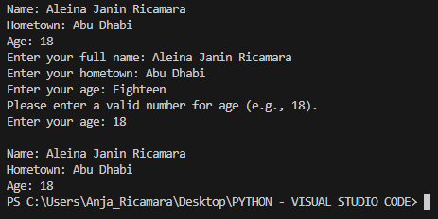

EXERCISE 3
OUTPUT

Slide 5


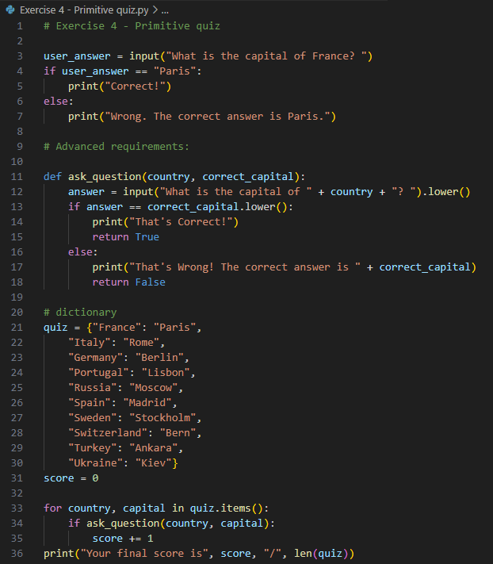
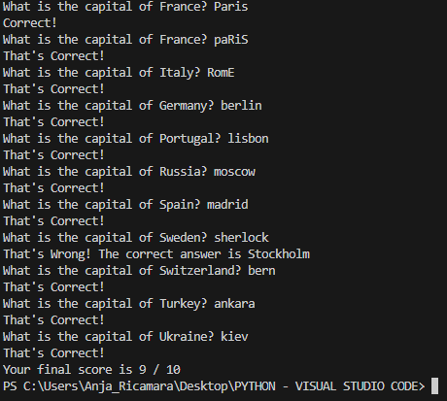


EXERCISE 4
OUTPUT

Slide 6

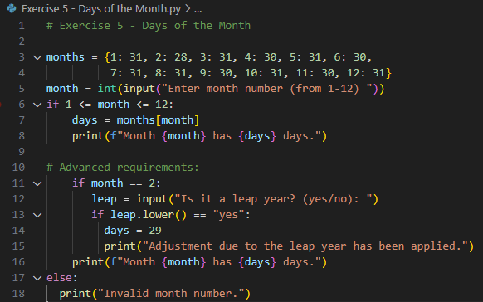
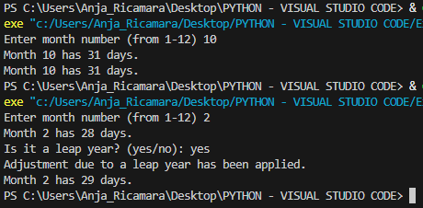
EXERCISE 5
OUTPUT

Slide 7


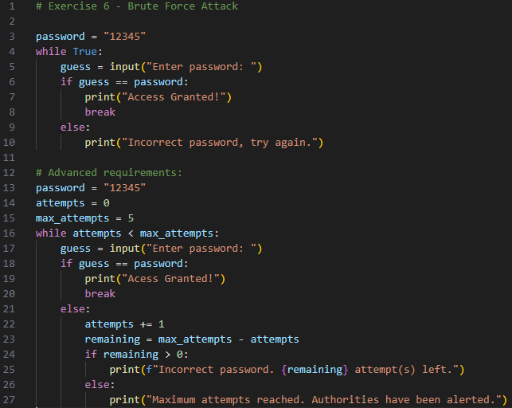
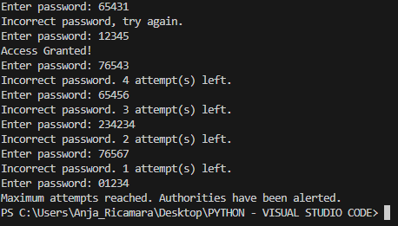
EXERCISE 6
OUTPUT

Slide 8


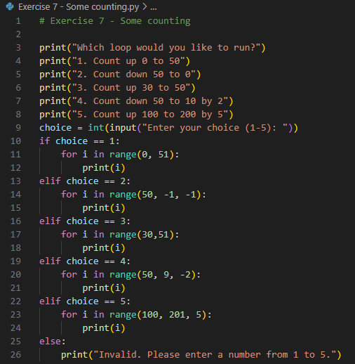
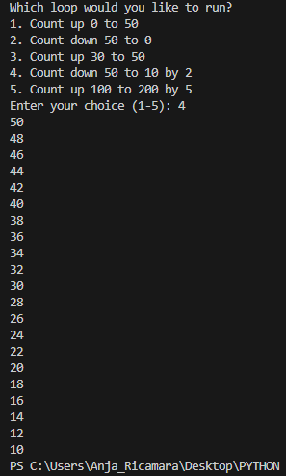
EXERCISE 7
← OUTPUT

Slide 9


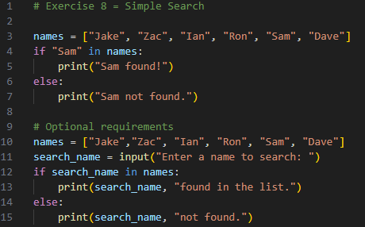
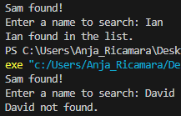

EXERCISE 8
OUTPUT

Slide 10

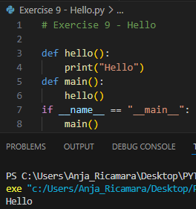

EXERCISE 9
->
OUTPUT

Slide 11

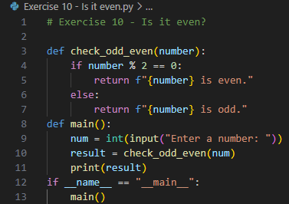
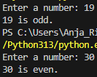

EXERCISE 10
OUTPUT

